Slide 1

UNIT 1: Back to school.
B. NAMES AND ADDRESSES

Slide 2
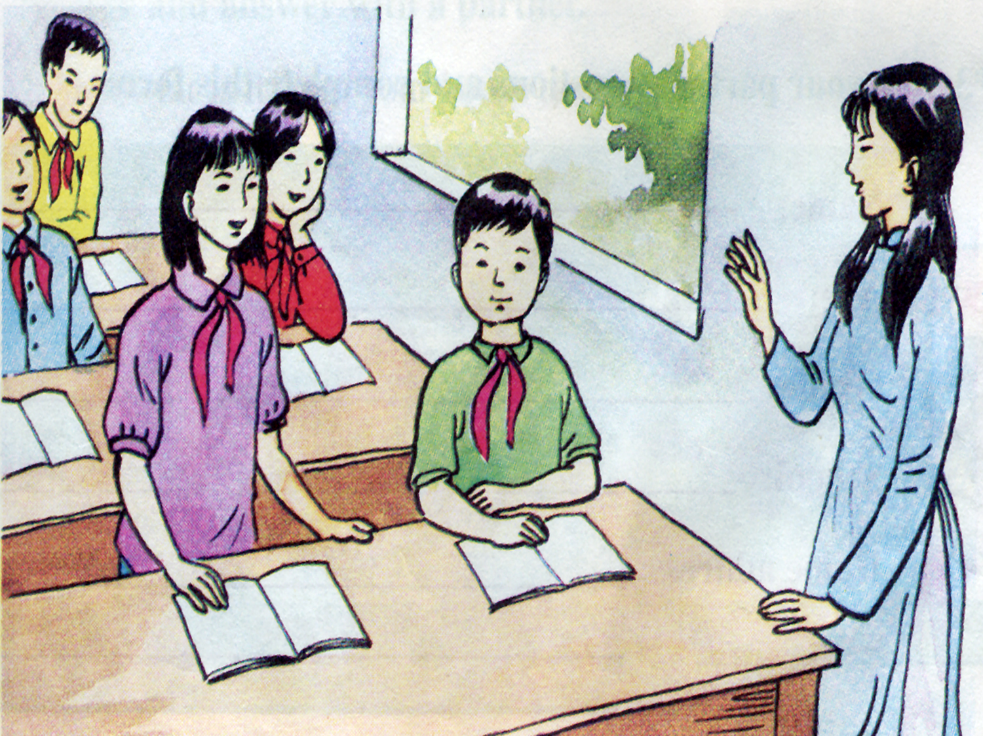
Hoa’s teacher
Hoa

Slide 3
I. Vocabulary:
Pham Thi Hoa 12 Tran Hung Dao Street
Family name
middle name
first name
address
full name

Slide 4
Unit 1: Back to school
Lesson: B
Names and addresses
I. Vocabulary:
- family name
= surname
- middle name
- an address
II. Listen to the radio:

Slide 5


Miss Lien: What’s your family name, Hoa?
Hoa : It’s Pham. My middle name’s Thi
Miss Lien: How old are you?
Hoa : I’m 13
Miss Lien : Where do you live ?
Hoa : 12 Tran Hung Dao Street,
Miss Lien: Thank you, Hoa
a. Hoa is talking to Miss Lien
Now answer
Who is Hoa talking to ?
What is Hoa’s family name?
What’s her middle name?
Where does she live?

Slide 6
Miss Lien: What’s your family name, Hoa?
Hoa : It’s Pham. My middle name’s Thi
Miss Lien: How old are you?
Hoa : I’m 13
Miss Lien : Where do you live ?
Hoa : 12 Tran Hung Dao Street,
Miss Lien: Thank you, Hoa
a. Hoa is talking to Miss Lien
Now answer
Who is Hoa talking to ?
What is Hoa’s family name?
What’s her middle name?
Where does she live?
b. It’s Pham

Slide 7
Miss Lien: What’s your family name, Hoa?
Hoa : It’s Pham. My middle name’s Thi
Miss Lien: How old are you?
Hoa : I’m 13
Miss Lien : Where do you live ?
Hoa : 12 Tran Hung Dao Street,
Miss Lien: Thank you, Hoa
a. Hoa is talking to Miss Lien
Now answer
Who is Hoa talking to ?
What is Hoa’s family name?
What’s her middle name?
Where does she live?
b. It’s Pham
c. It’s Thi

Slide 8
Miss Lien: What’s your family name, Hoa?
Hoa : It’s Pham. My middle name’s Thi
Miss Lien: How old are you?
Hoa : I’m 13
Miss Lien : Where do you live ?
Hoa : 12 Tran Hung Dao Street,
Miss Lien: Thank you, Hoa
a. Hoa is talking to Miss Lien
Now answer
Who is Hoa talking to ?
What is Hoa’s family name?
What’s her middle name?
Where does she live?
b. It’s Pham
c. It’s Thi
d. She lives at 12 Tran Hung Dao Street

Slide 9
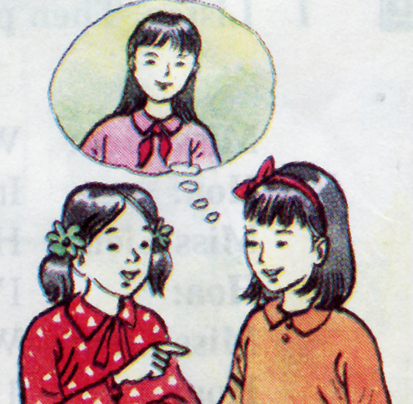
IV. Write. Complete this dialogue
Who
Nga: ………is that?
Lan: That’s Nam.
Nga: No, ………is the girl talking to meet Lien?
Lan: Her name’s Hoa. She’s a new student.
Nga: ………class is she in?
Lan: She’s in out class 7A
Nga: ………does she live?
Lan: She lives on Tran Hung Dao Street
with her aunt and uncle.
Nga: ………do her parents live?
Lan: They live in Hue.
Nga: She’s tall. ………old is she?
Lan: She’s 13.
Who
What
Where
Where
How

Slide 10
I.Structure:
How far : ask about the distance (bao xa)
How far is it from ...............to............?
It’s about ………….. kilometer (s)
meter (s)
Eg1 : How far is it from your house to school ?
→ It’s about 2 kilometers.
400 meters.
Eg2 : How far is it from the bank to the bus stop ?
→ It’s about 1 kilometer.

Slide 11
II. Practice :
B4. Practice the dialogue :
Nam : Where do you live, Hoa?
Hoa : I live at 12 Tran Hung Dao street.
Nam : How far is it from your house to school?
Hoa : It’s not far, about one kilometer.
Nam : How do you go to school?
Hoa : I go to school by bike.

Slide 12
*Answer the questions :
a.Where does Hoa live ?
b. How far is it from her house to school ?
c. How does she go to school ?
→ Hoa lives at 12 Tran Hung Đao Street.
→ It’s not far about 1 kilometer.
→ She goes to school by bike.

Slide 13
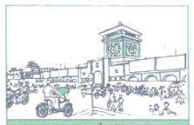
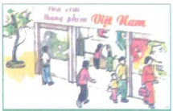
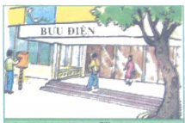
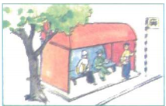
market
cinema
post office
bus stop

Slide 14
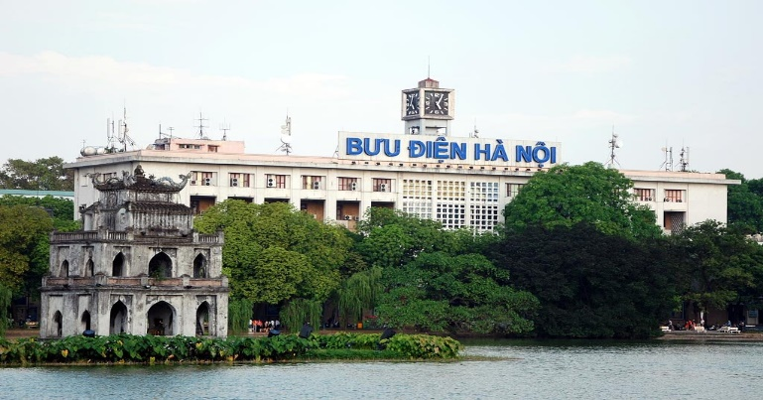
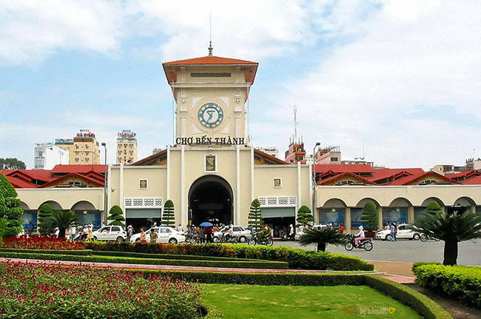
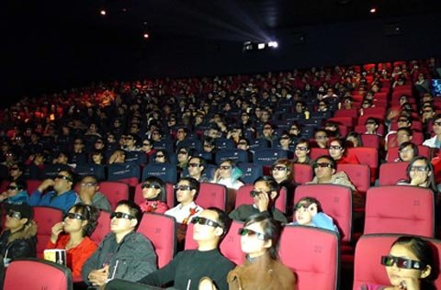

B5. Ask and answer with a partner:
How far is it from the ............... to the ............ ?
→ It’s about ………….. kilometer (s) / meter (s)
Post office
1 kilometer
Market
200
m
3
km
Movie theater
Bus stop
500 meters

Slide 15
How far is it from your house to school ?
It is about ……………..kilometer (s).
meters
2. How do you go to school ?
I go to school by ……………..
I walk to school . / I go to school on foot.

Slide 16
I. Ask and answer about the distance.
How far is it from…………….to……….?
→ It is (about)………………………..m/ km
Your house / school / 3km
2. The museum / the movies / 7 km
3. Ba’s house / the post office / 900m

Slide 17

Homework
Learn the lesson well.
- Prepare: Unit 2 (A1,3,4)

Slide 18





Thank you for your attention !
Thank you for your attention !

